Slide 1
Operating Systems
Components of OS
Instructor: Huma Javed
Lecture: 04

Slide 2
Contents
System Components
Operating System Services
System Calls
System Programs
System Structure
Virtual Machines

Slide 3
Common System Components
Process Management
Main Memory Management
File Management
I/O System Management
Secondary Storage Management
Networking
Protection System
Command-Interpreter System

Slide 4
Protection System
Protection refers to a mechanism for controlling access by programs, processes, or users to both system and user resources
The protection mechanism must:
  distinguish between authorized and unauthorized usage
  specify the controls to be imposed
  provide a means of enforcement

Slide 5
Command-Interpreter System
Many commands are given to the operating system by control statements which deal with:
  Process creation and management
  I/O handling
  Secondary-storage management
  Main-memory management
  File-system access
  Protection
  Networking

Slide 6
Command-Interpreter System (Cont.)
The program that reads and interprets control statements is called variously:
  command-line interpreter
  shell (in UNIX)
Its function is to get and execute the next command statement

Slide 7
Process Management
Creation/deletion of a process
Create and make available, an execution environment
Suspension/resumption and CPU scheduling in a fair manner
Mechanisms for synchronization
Mechanisms for inter-process communication
Deadlock handling

Slide 8
Operating System Services
Program execution – system capability to load a program into memory and to run it
I/O operations – since user programs cannot execute I/O operations directly, the operating system must provide some means to perform I/O
File-system manipulation – program capability to read, write, create, and delete files
Communications – exchange of information between processes executing either on the same computer or on different systems tied together by a network. Implemented via shared memory or message passing
Error detection – ensure correct computing by detecting errors in the CPU and memory hardware, in I/O devices, or in user programs

Slide 9
System Calls
System calls provide the interface between a running program and the operating system
  Generally available as assembly-language instructions
  Languages defined to replace assembly language for systems programming allow system calls to be made directly (e.g., C, C++)
Three general methods are used to pass parameters between a running program and the operating system
  Pass parameters in registers
  Store the parameters in a table in memory, and the table address is passed as a parameter in a register
  Push (store) the parameters onto the stack by the program, and pop off the stack by operating system

Slide 10
Virtual Machines
A virtual machine takes the layered approach to its logical conclusion. It treats hardware and the operating system kernel as though they were all hardware
A virtual machine provides an interface identical to the underlying bare hardware
The operating system creates the illusion of multiple processes, each executing on its own processor with its own (virtual) memory

Slide 11
Virtual Machines (Cont.)
The resources of the physical computer are shared to create the virtual machines
  CPU scheduling can create the appearance that users have their own processor
  Spooling and a file system can provide virtual card readers and virtual line printers
  A normal user time-sharing terminal serves as the virtual machine operator’s console

Slide 12

System Models
Non-virtual Machine
Virtual Machine

Slide 13
Advantages/Disadvantages of Virtual Machines
complete protection of system resources since each virtual machine is isolated from all other virtual machines. This isolation, however, permits no direct sharing of resources.
a perfect vehicle for operating-systems research and development. System development is done on the virtual machine, instead of on a physical machine and so does not disrupt normal system operation.
difficult to implement due to the effort required to provide an exact duplicate to the underlying machine

Slide 14
Java Virtual Machine
Compiled Java programs are platform-neutral byte-codes executed by a Java Virtual Machine (JVM)
JVM consists of
  Class loader
  Class verifier
  Runtime interpreter
Just-In-Time (JIT) compilers increase performance

Slide 15
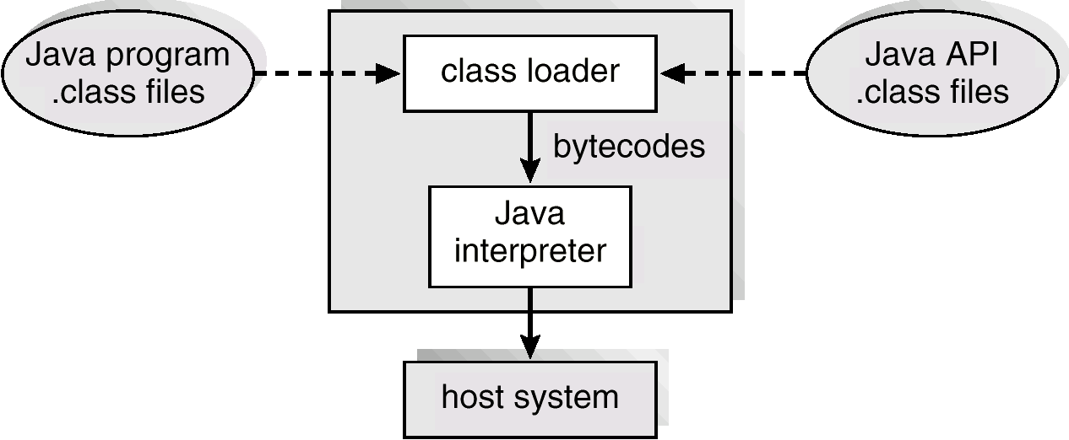
The Java Virtual Machine

Slide 16
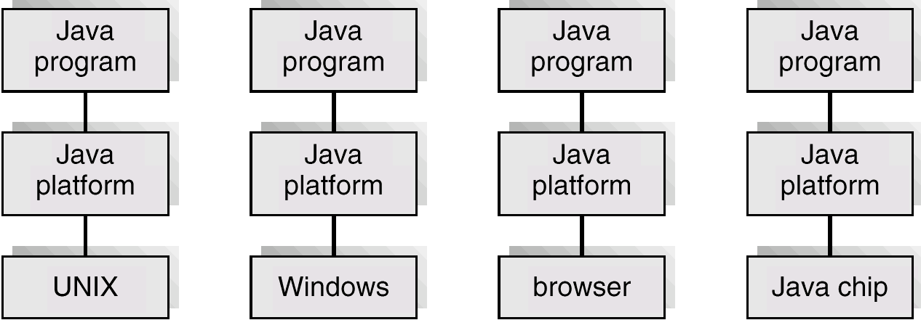
The Java Platform

Slide 17
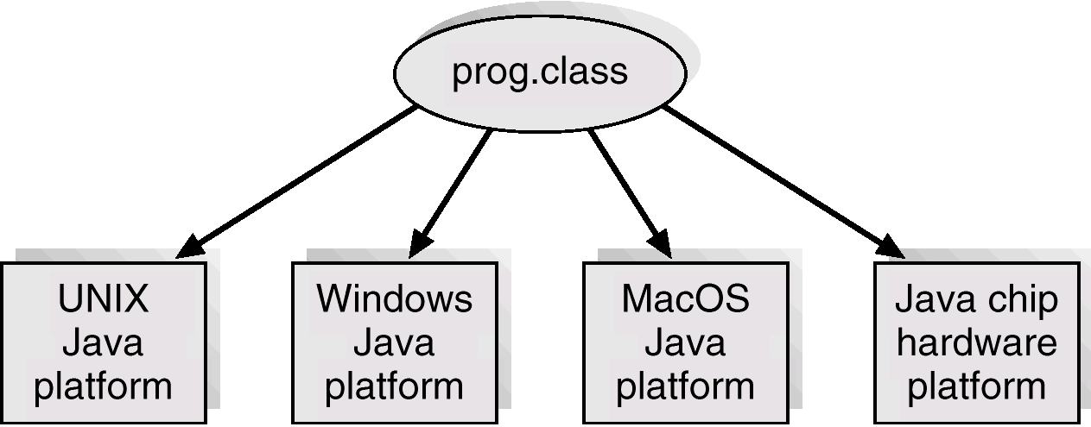
Java .class File on Cross Platforms

Slide 18
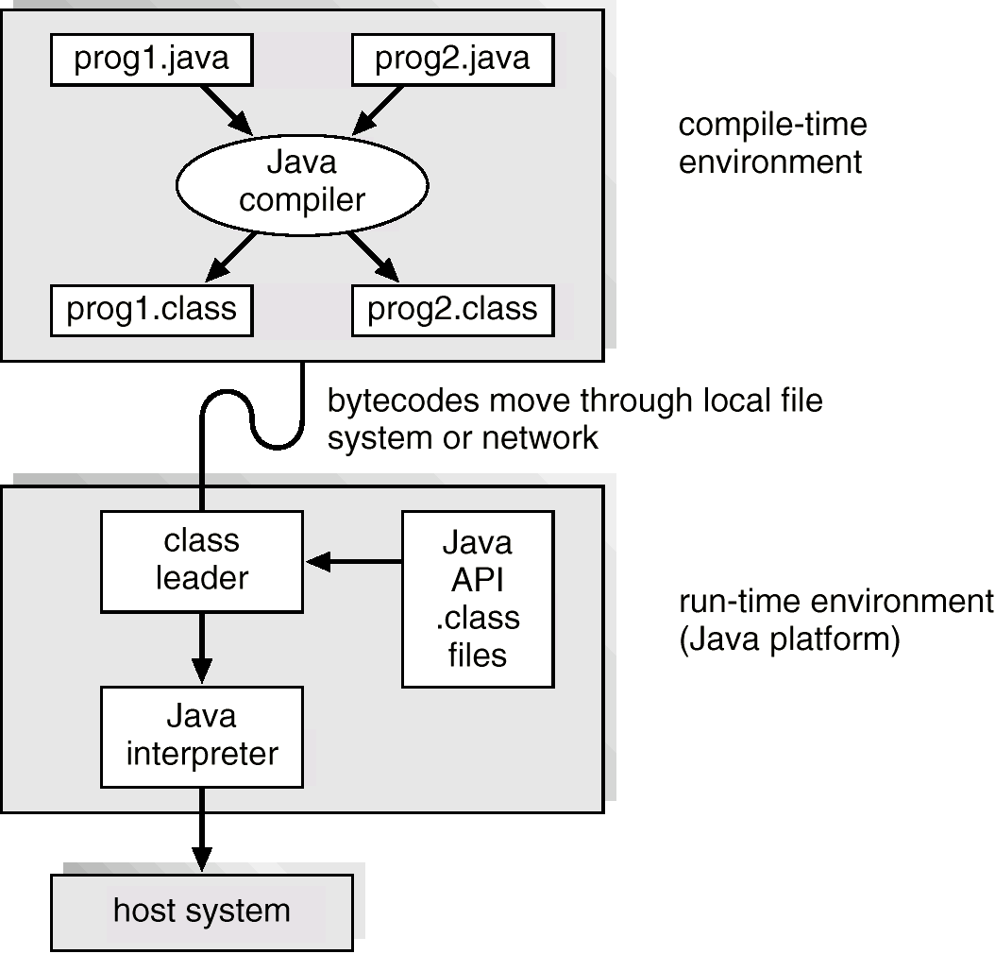
Java Development Environment

